Slide 1

PGB Session
19 March 2025
Paul Wormeli, Chairman
NIEMOpen Project Governing Board

Slide 2
VENUE
PGB Meeting
19 March 2026
Virtual Meeting 2-4 PM EST
19 March 2026
PGB Zoom Meeting
Join Zoom Meeting https://us06web.zoom.us/j/8016452879?pwd=a3hNN0dieVJPR1pZY2QwbHVXbFJTUT09&omn=85908180890
Meeting ID: 801 645 2879 Passcode: 676136
One tap mobile +13052241968,,8016452879#,,,,*676136# US +13092053325,,8016452879#,,,,*676136# US
Join instructions https://us06web.zoom.us/meetings/85908180890/invitations?signature=v7ueE3VX0wciFxK86TDOvU4-uHxhSlMjSZeynaKxCXo
PGB Minutes & documents: https://github.com/niemopen/oasis-open- project/tree/main/pgb-meeting-minutes

Slide 3



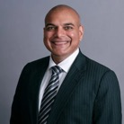




SPONSOR APPOINTED PGB VOTING MEMBERS
Mr. Paul Wormeli
IJIS Institute
Chair, NIEMOpen
Project Governing Board
Mr. John Wandelt Principal Research Scientist, Georgia Tech Research Institute
Mr. Yogesh Chawla
Director, Software and Data Engineering
SEARCH
Ms. Christina Bapst-Stump
Science and Technology Directorate,
US Department of Homeland Security
Ms. April Mitchell FBI It Specialist and Technical Lead of Data Standards in the Criminal Justice Information Services (CJIS) Division
Mr. Tom Welch Director of Information Technology OHIO HIDTA –
Including Northern KY & Western PA
Mr. Jeff Butcher
Chief Software Architect,
Senzing, Inc.
Mr. Jose Plehn
CEO and Founder
BrightQuery

Slide 4
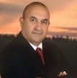


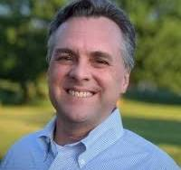

PGB EXPERT VOTING MEMBERS & NON-VOTING MEMBERS
PGB EXPERT VOTING MEMBERS
Technical Steering Committees
PGB EXPERT NON-VOTING MEMBERS
Technical Steering Committees
Mr. Brad Bolliger Co-Chair, NIEM Technical Architecture Committee TSC
Mr. Kamran Atri Co-Chair, NIEM Business Architecture Committee TSC
Dr. Scott Renner Co-Chair, NIEM Technical Architecture Committee TSC
Mr. Thomas Krul Co-Chair, NIEM Business Architecture Committee TSC
Mr. Jim Cabral - NTAC TSC

Slide 5


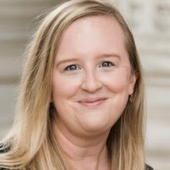
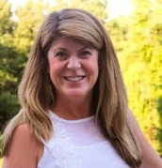
OASIS STAFF
Mr. James Bryce Clark –
OASIS General Counsel
Ms. Holly Peterson – OASIS Business Development Manager
Ms. Kelly Cullinane – OASIS Senior Director of Standards Development
Ms. Cathie Mayo – OASIS Chief Financial Officer

Slide 6
ROLL CALL
PGB Sponsor Voting Members (8):
Criminal Justice Information Systems Division (CJISD), Federal Bureau of Investigation
Department of Homeland Security Science & Technology (DHS S&T)
Georgia Tech Research Institute (GTRI)
IJIS Institute (IJIS)
National Association for Justice Information Systems (NAJIS)
Senzing, Inc.
SEARCH | The National Consortium for Justice Information and Statistics
Bright Query
PGB Expert Voting Members (2)
NBAC TSC
NTAC TSC
PGB Expert NON-Voting Members (3)
Quorum: 6
Notes:
Voting Members
Mr. Jim Herbert - All Purpose Networks (APN)
Ms. Christina Bapst-Stump - Department of Homeland Security Science & Technology (DHS S&T)
Mr. John Wandelt - Georgia Tech Research Institute (GTRI)
Mr. Paul Wormeli - Integrated Justice Information Systems Institute (IJIS)
Mr. Payton Lamb - Commonwealth of Virginia, Office of Data Governance and Analytics (ODGA)
Ms. April Michell - Criminal justice Information Systems Division (CJISD), Federal Bureau of Investigation
Mr. Tom Welch - National Association for Justice Information Systems (NAJIS)
Expert Voting Members
NBAC TSC - Mr. Thomas Krul (National Defence Canada)
NTAC TSC – Mr. Jim Cabral
PGB Expert Non-Voting Members(4)
NBAC TSC – Mr. Kamran Atri (A4Safe),
NTAC TSC – Mr. Brad Bolliger (EY)
Dr. Scott Renner (MITRE)

Slide 7
APPROVAL OF December 4 2025 PGB MINUTES
Chair: A Draft of the NIEMOpen 4 December 2025 PGB meeting minutes was provided to the PGB Voting/Expert Voting Members as a readahead: Please let me know now if you found any errors:
https://github.com/niemopen/oasis-open-project/blob/main/pgb-meeting-minutes/2025/4-dec-25/DRAFT%20NIEMOpen%20PGB%20Minutes%20December%204%2C%202025.docx
Motion 1: The December 4, 2025 minutes are approved as read

Slide 8
PROPOSED MARCH 19 2026 AGENDA
Call to Order
Admin
Call to Order
Roll Call & Introductions
Sponsor Appointed PGB Voting Members (Sponsors)
PGB Expert Voting Members (TSCs) & Non-Voting Members (TSC Co-Chairs)
Approval of Meeting Agenda
2026 Initiatives
Basic Formal Ontology
DAMA Book of Knowledge
Stakeholder survey
Sponsor/Volunteer Recruitment
Other Business
Next Meeting Schedule
Other Business/Discussion
Around-the-Horn – PGB Voting Member Comments/Questions
Adjourn
Reports
NIEMOpen Progress
OASIS Standard
ISO Path—Kelly Cullinane (OASIS)
NTAC Update –Brad Bolliger& Dr. Scott Renner
NIEMOpen Toolset Roadmap—Jim Cabral
NBAC Update – Thomas Krul & Kamran Atri
Q1 2026 Financial Snapshot – Cathie Mayo (OASIS)

Slide 9
PROGRESS REPORT: Q1
V.6.0 progress
NDR 6.0 and NDR are OASIS Standards
Successful Forensics Townhall 8 December 25
Advances in API 2.0, NIEM Toolbox
Implementing PGB Decisions
Defining 2026 objectives

Slide 10
Project management—IJIS statement of work
Scope of Work – Deliverables
1. PGB Meeting Support
2. Inquiry Triage Management
3. AI‑Based Help Desk Design
4. Social Media Management
5. Website Content Updates
6. Technical Contract Oversight
7. Volunteer Recruitment Support
8. Strategic Plan Updates
Costs
- Total Work Order cost is limited to $40,000

Slide 11
ISO Path
1. Approval as an OASIS Standard (Completed)
2. Request to Submit to ISO/IEC JTC 1 (Completed)
3. Preparation of Submission Package and Explanatory Report
4. Submission and JTC 1 Review Process
5. Handling of Comments and Final Approval

Slide 12
NTAC Update
NTAC is reporting five priorities for 2026:
Publish V6.0 as an ISO Standard (Completed)
Deploy and test full tools suite
Incorporate new domains
Establish a new release life cycle
Determine the content of V7.0
Some other NTAC objectives postponed
Implement AI based Support Services
Automate model management using AI
Internationalize NIEMOpen Model and assets

Slide 13
NIEMOpen toolpath
Jim Cabral

Slide 14
NIEMOpen Tools v6 Message Specification Pipeline
Input | Output | CMFTool | API 2.0 | NIEMToolbox | any XML editor
Requirements | UML
UML | Mapping (template)
Reference Model | Search UI |  | Y | API 2.0
Mapping (template), Search UI | Mapping
Mapping (template), MCP API | Mapping
Reference Model, Mapping | Model Conformance
Mapping | CMF
CMF | CMF Conformance | Y | CMFTool
CMF | Schemas | Y | CMFTool
Schemas | Schema Conformance | Y | CMFTool | CMFTool
Schemas | Instances |  |  |  | Y
Instances | Instance Conformance |  | Y | API 2.0
XML/MPD catalogs | Catalog Conformance |  | Y
Requirements, Instances | Requirements Met

Slide 15
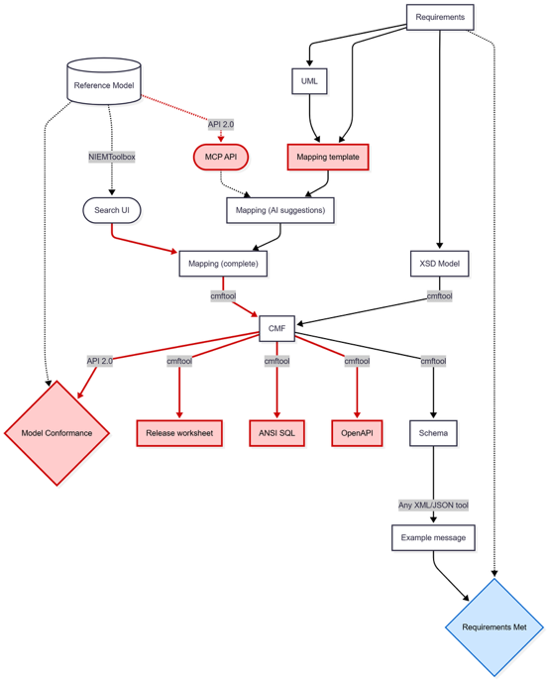
NIEMOpen Tools Recommendations
Standardized mapping templates
Message specifications
Releases/domain updates
CMFTool enhancements
Document how to use (in progress)
Test XML/JSON interoperability (in progress)
Import message mappings
Export ANSI SQL, OpenAPI and release worksheet
API 2.0/NIEMToolbox enhancements
Save mappings in Search UI
Expose a Model Context Protocol (MCP) API (to enable third party AI tools)
Validate Model Conformance of a CMF

Slide 16
NIEMOpen Tools Workflows for v6
To develop v6 message specifications TODAY:
Model your data (e.g., UML)
Map your data in a mapping spreadsheet to NIEMOpen v6
Generate NIEM XSD (in any XML editor)
Use CMFTool to
Generate CMF from XSD
Generate XML and JSON message schemas
Generate example instances from the schemas (in any XML editor)
In the near future, hopefully you will be able to:
Model your data (e.g., UML)
Use an AI tool of choice to map your data in a mapping spreadsheet to NIEMOpen v6
Use CMFTool to
Generate CMF from the mapping
Generate XML and JSON message schemas
Generate example instances from the schemas (in any XML editor)

Slide 17
NIEMOpen Tools Updates to Training for v6
Support the Latest NDR
Explain how to create JSON schemas
Explain the use of new tools (CMF, API 2.0, etc.)
Describe current and future recommended workflows for using Version 6.0 and beyond

Slide 18
Motion 2: The PGB accepts and endorses the recommendations of NTAC on tool development and commits to seek resources for implementation.

Slide 19
New release planning
Major release (e.g. NIEM 7)
May include technical architecture change
May include breaking changes to core
Review requirements and change requests every five years
Core updates
Only non-breaking changes to core (adding new components)
Domain updates are optional
When needed
Domain updates
Breaking or nonbreaking changes to a domain model
Domains can coordinate for inter-domain harmonization
When needed
Motion 3: The PGB accepts and endorses the recommendations of NTAC on release planning.

Slide 20
Software engineering update
Added subset support (search and saving) to the NIEM Toolbox
Drafted wantlist 3.0 for the JSON format
The API has been updated to use the latest versions of CMF and the CMF tool
NIEM Toolbox has been updated to use the new API
Updated and improved directory handling in github and website

Slide 21
NBAC Update
2025 Year in Review
Forensics domain initiated
Analytical Laboratory Plan prepared
These 2 new domains will inject over 1,400 attributes to the model and code list
Supported enhancements to finalize NIEM 6.0
Supported new naming convention
Approx. 10 NBAC sessions
Assisted and helped transition NIEM from DoD to NIEMOpen under OASIS
2026 Plans
Support Forensics domain onboarding
Identify new chair for Analytical laboratory domain
Initiate Digital Identity Domain
Try to improve NBAC cadence and participation

Slide 22
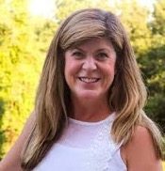
CY 2025 Q3 FINANCIALS
Ms. Cathie Mayo – OASIS Chief Financial Officer

Slide 23
CY/FY 2025 Q3 FINANCIALS
Fy2024 Balance Forward $ ^{143,822.81}
y2025 Funding
2025- Ql $ 20,000
2025- Q2 $ ^{20,000}
2025- Q3 $ 44,000
2025- Q4 YTD $ 1,300
Fy2025 Funding $ ^{85,300}
Fy2025 Total Funds Available YTD $ ^{229,123}
Expenditures
2025- Ql $ (3,025)
2025- Q2 $ (4,644)
2025- Q3 $ (3,109)
2025- Q4 YTD $ (4,682)
Fy2025 Expenses $ ^{(15,460)}
GTRI SOW 2025-1 Reserve $ ^{(100,000)}
NPC Leadership Meeting. $ ^{(2,000)}
Ending Balance 2025- Q4 $ ^{111,663}
Summary:
FY 2024 Balance Forward | $143,823
FY 2025 Funding | 86,600
FY Total funds Available YTD | 230,422
Expenditures 2025 YTD | 70,904
Current Obligations | 86,112
Ending Balance 2025-Q4 | 73,406

Slide 24

BREAK

Slide 25
2026 Initiatives
March 19, 2026

Slide 26
Initiatives
Basic Formal Ontology
DAMA Book of Knowledge
Stakeholder Survey
Sponsor/Volunteer Recruitment

Slide 27

NIEMOpen is:
An open source framework
for building a consensus on
data standards that facilitate
information sharing
across domains and across nations

Slide 28
NIEMOpen and the Basic Formal Ontology (BFO)
The Basic Formal Ontology (BFO) is a small, upper level ontology that is designed for use in supporting information retrieval, analysis and integration in scientific and other domains.
BFO is used by more than 550 ontology-driven endeavors throughout the world.
Introduction to BFO--https://www.youtube.com/watch?v=p0buEjR3t8A&list=PLyngZgIl3WTg5f36E7r3W5px_58OOWE5I
NTAC to study collaboration possibilities

Slide 29

Mission:
DAMA-I serves global data citizens by providing a community space for knowledge sharing, recognizing professional achievement, and promoting ethical and effective data practices, resulting in responsible and effective data management worldwide.

Slide 30
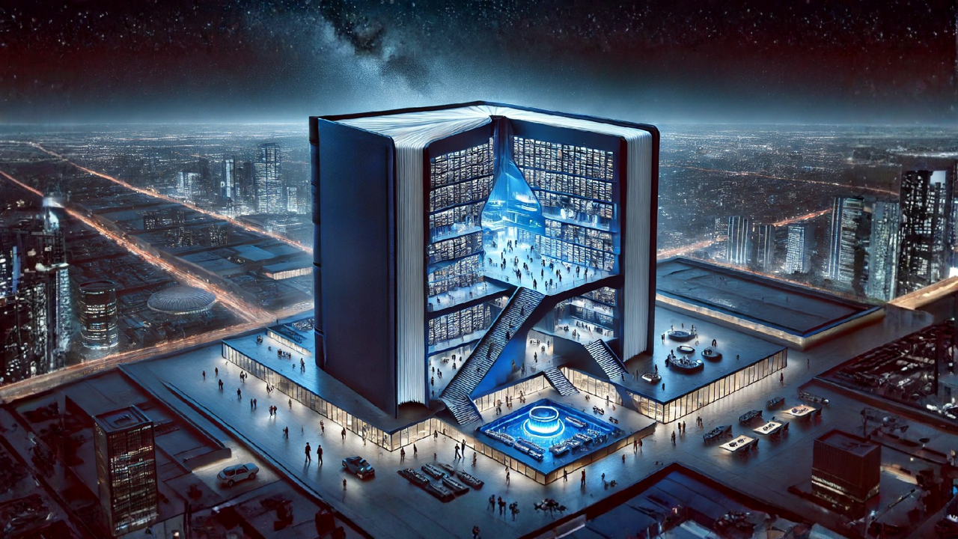





DAMA-DMBOK®
DATA MANAGEMENT BODY OF KNOWLEDGE
PHYSICAL BOOK
DIGITAL CONTENT MANAGEMENT SYSTEM

Slide 31
DAMA-DMBOK® 3.0 FOCUS GROUP SESSIONS
NIEMOpen: 2 focus groups, Spring and summer 2026
8-10 people per group, 2-hour focus group
Open to NBAC, NTAC, PGB members

Slide 32
NIEMOpen Community Survey
Use, Requirements, Satisfaction
Survey design committee
Survey and analysis by IJIS
PGB Briefing

Slide 33
BOARD PRESENTATION | 2026
Building a Sustainable Future
A Campaign to Recruit Sponsors & Volunteers for NiEMOpen
Growing Need
Community Power
12-Month Plan
Expanding user base
requires sustained support
Volunteers & sponsors
drive open-source success
Structured campaign
with clear milestones
1

Slide 34
THE CASE FOR ACTION
Why We Need This Campaign
⚠
Resource Constraints
📈
Accelerating Demand
NiEMOpen relies on a limited pool of volunteers and lacks dedicated funding, creating bottlenecks in development, testing, and release cycles.
Adoption of NiEMOpen is growing across government agencies and industry. Without matching resource growth, quality and responsiveness will decline.
🏛
Long-Term Governance
🤝
Community Expectations
Formal sponsor relationships ensure continuity of leadership and resources beyond individual volunteers, providing institutional stability.
Stakeholders and users expect a roadmap with predictable delivery. A funded, volunteer-rich program signals commitment and professionalism.
2

Slide 35
HIGH-LEVEL STRUCTURE
Campaign Components
💰 SPONSOR TRACK
🤝 VOLUNTEER TRACK
▸ Tier Structure
▸ Role Definition
Define Bronze / Silver / Gold tiers with clear benefits, recognition, and contribution levels.
Map required volunteer roles — developers, reviewers, educators, governance leads — with time commitments.
▸ Prospect Outreach
▸ Recruitment Channels
Identify and engage government agencies, standards bodies, and technology vendors aligned with NIEM.
Partner with universities, professional associations, and existing NIEM stakeholders for outreach.
▸ Value Proposition Kits
▸ Onboarding Program
Develop tailored materials articulating ROI for each sponsor category.
Create structured onboarding documentation, mentorship pairings, and contribution toolkits.
▸ Stewardship & Reporting
▸ Recognition & Retention
Establish quarterly sponsor briefings and transparent fund-usage reporting.
Launch contributor badges, annual recognition events, and career-development incentives.
3

Slide 36
12-MONTH EXECUTION PLAN
Campaign Timeline
Q1
Q2
Q3
Q4
Foundation
Launch
Activation
Consolidation
Board approval
Campaign team formed
Branding & materials
Sponsor outreach begins
Volunteer recruitment
Website & portal live
First sponsors confirmed
Onboarding cohort #1
Progress reporting
Annual review
Tier 2 outreach
Roadmap for Year 2
Board Action Requested: Approve the NiEMOpen Sponsorship & Volunteer Campaign and authorize formation of the Campaign Steering Committee by end of Q1 2025.
4

Slide 37








NIEMOpen Current Sponsors
9 Sponsors, 3 Premier
Sponsors
Bright Query
DHS S&T
CJIS (FBI)
GTRI
NAJIS
IJIS
Senzing
SEARCH
Premier
Premier
Potential Sponsors
Federal agencies
State and local agencies
Private Sector
Non-governmental agencies
International agencies

Slide 38


PGB MEMBERS: AROUND-THE-HORN

Slide 39
PGB Meeting Schedule – Pending Approval
NEXT PGB Meeting
Thursday, June 18, 2026
Virtual Meeting 2 – 4 PM EST
Virtual: ZOOM
CY 2026 Meeting Dates
Q1 | MAR 19 | 2 – 4 PM | EDT
Q2 | JUN 18 | 2 – 4 PM | EDT
Q3 | SEP 17 | 2 – 4 PM | EDT
Q4 | DEC 3 | 2 – 4 PM | EST

Slide 40

Real-World Success Factors
Structure
Commitment
Participation
Collaborative and transparent governance committees
Become a sponsor
Allocate time to serve
Conform to standards
Join relevant committees
Attend meetings
Make contributions

Slide 41






The Path Forward
NIEMOpen as a Collaborative Community
Build Out the Community
Commit Fully
Grow Together

Slide 42


CONCLUSION

